Slide 1
F1nance
UML Sequence Diagram

Slide 2
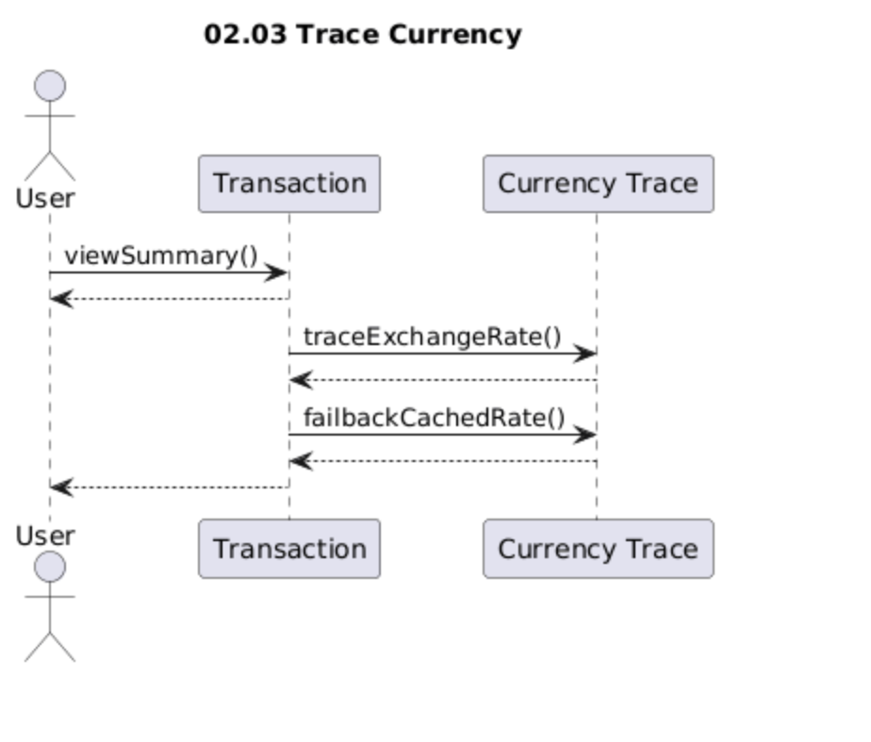
F1nance UML Sequence Diagram
Use Case Scenario
The user opens the transaction view and calls viewSummary() to see recent movements for a chosen account.
From there, the system uses the Transaction object to contact Currency Trace and call traceExchangeRate() so that it can determine how the currency value has changed over time.
If live data is not ideal, the system then calls failbackCachedRate() to retrieve a stored rate for comparison. Finally, the user sees a summary that combines the transaction list with the traced exchange rate information.

Slide 3
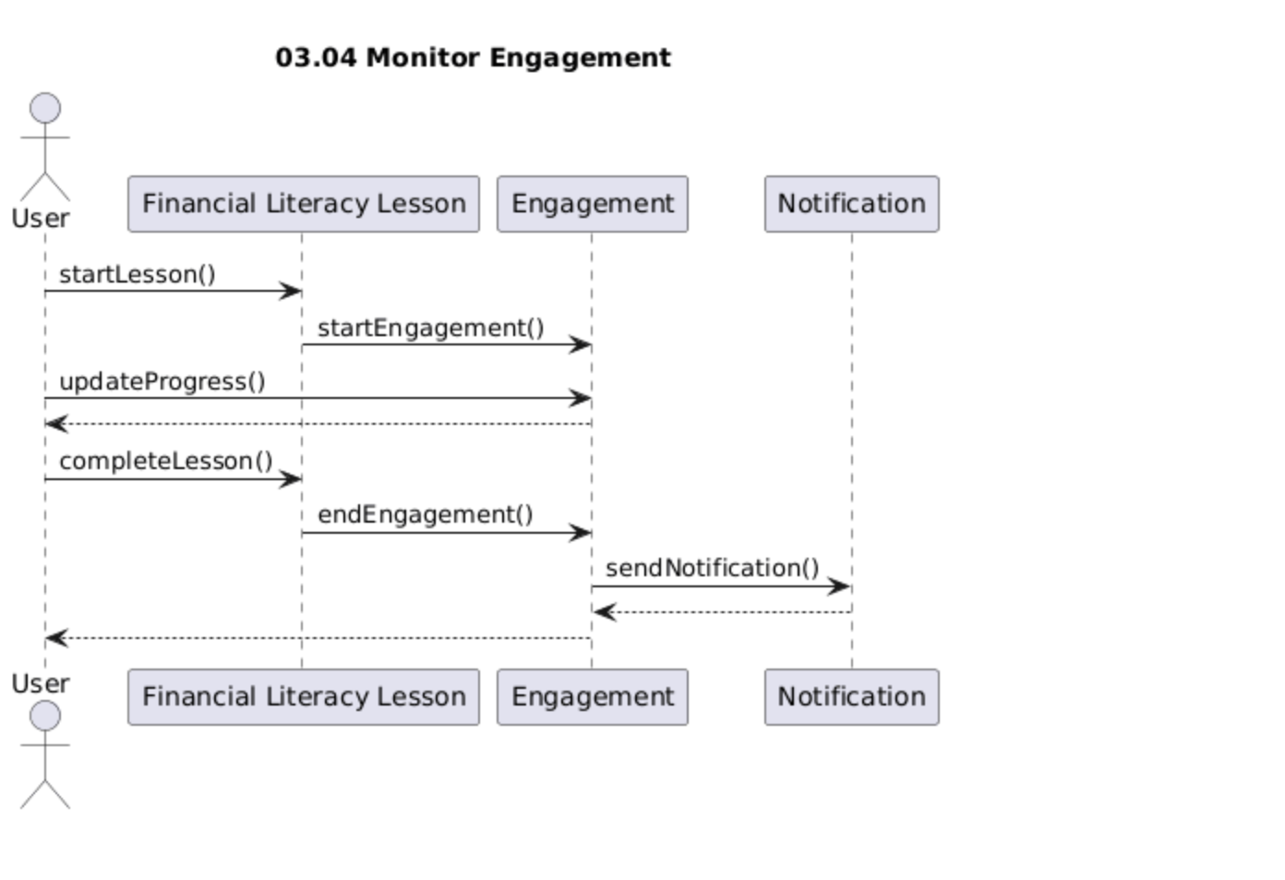
F1nance UML Sequence Diagram
Use Case Scenario
The user starts a financial literacy lesson, which triggers startLesson() on the Financial Literacy Lesson object and startEngagement() on Engagement to begin tracking activity.
While the lesson is in progress, the user’s actions cause updateProgress() to be called so time spent and progress are recorded.
When the user finishes, completeLesson() is called and endEngagement() closes the engagement session.
Based on the recorded data, Engagement decides whether to call sendNotification() on Notification, so that the user can be reminded, encouraged, or informed about their learning activity.

Slide 4
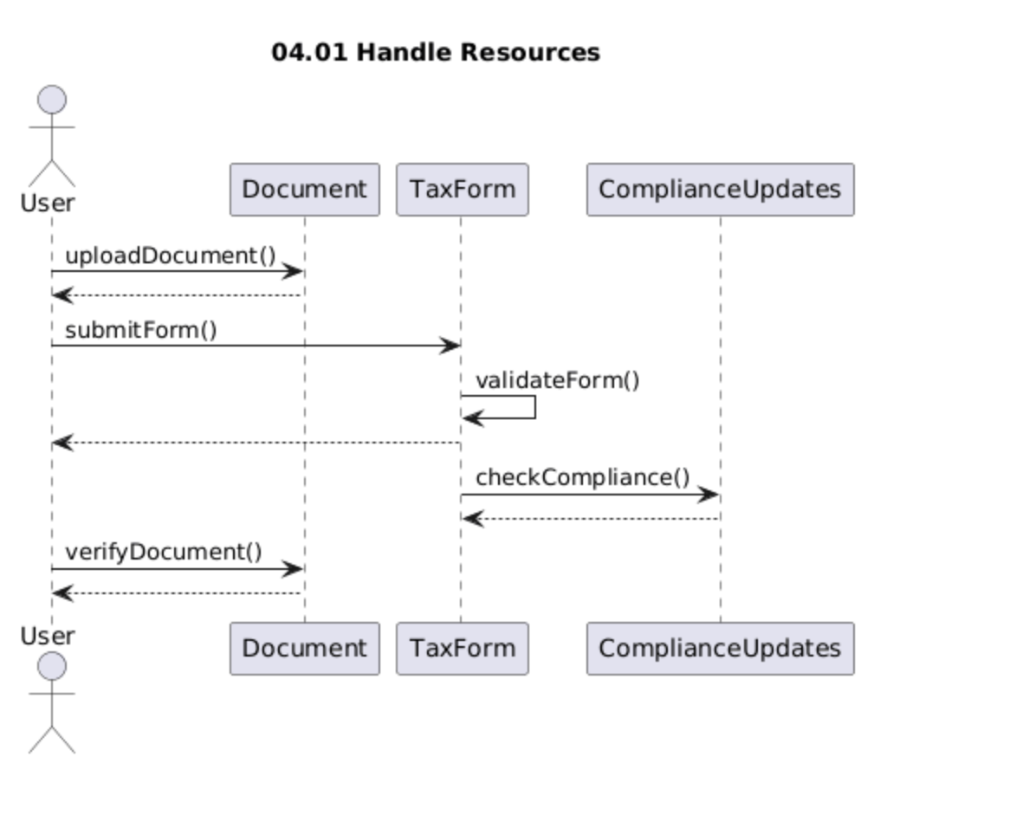
F1nance UML Sequence Diagram
Use Case Scenario
The user uploads a supporting file such as an ID or statement, which calls uploadDocument() on Document and stores the file for later checks.
When the user fills in a tax-related form, the system sends the submission through submitForm() on TaxForm, which internally runs validateForm() to make sure the details are correct.
After validation, the form data is sent to ComplianceUpdates via checkCompliance() to confirm that current regulations are being followed.
Later, the user can call verifyDocument() so that the system confirms the status of the uploaded document and reports the result back.

Slide 5
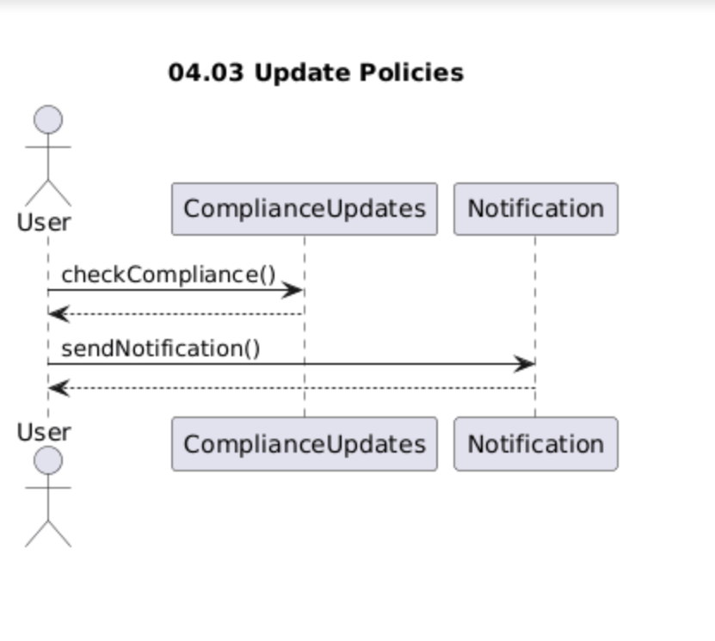
F1nance UML Sequence Diagram
Use Case Scenario
The user, acting as a compliance officer, wants to confirm that the organisation is still aligned with the latest rules.
They trigger checkCompliance() on ComplianceUpdates, which reviews stored policies, tax forms, and related data to produce an updated compliance status.
Once the review is complete, the officer uses sendNotification() on Notification so that all affected users or internal staff are informed about any important policy or compliance updates they need to know.

Slide 6
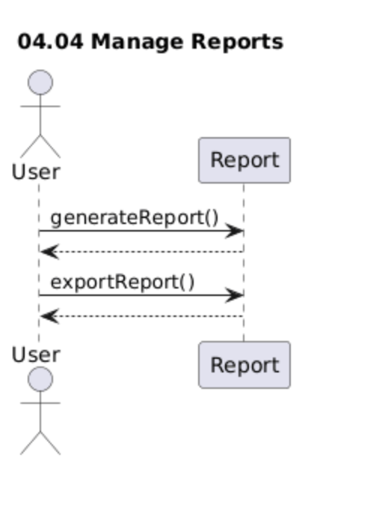
F1nance UML Sequence Diagram
Use Case Scenario
The user wants a summary of recent financial or compliance activity, so they call generateReport() on the Report object.
The system gathers underlying data (transactions, engagements, or compliance checks) and builds a report view for the user to read on screen.
When the user is satisfied and wants an offline copy, they call exportReport(), and the system produces an exported file that the user can download or share.

Slide 7
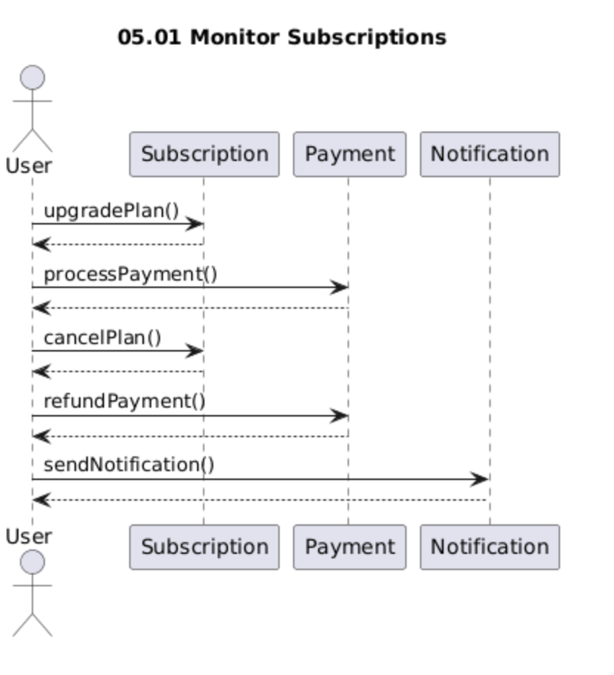
F1nance UML Sequence Diagram
Use Case Scenario
The user reviews their current subscription in the app and decides to move to a higher plan, which triggers upgradePlan() on Subscription.
To pay for this change, the user calls processPayment() on Payment, and once that succeeds the subscription details are updated.
If later the user decides not to continue, they use cancelPlan() on Subscription, and, if needed, call refundPayment() on Payment to request a refund according to the rules.
Throughout these actions, sendNotification() on Notification is used to inform the user about successful upgrades, cancellations, or refunds.

Slide 8
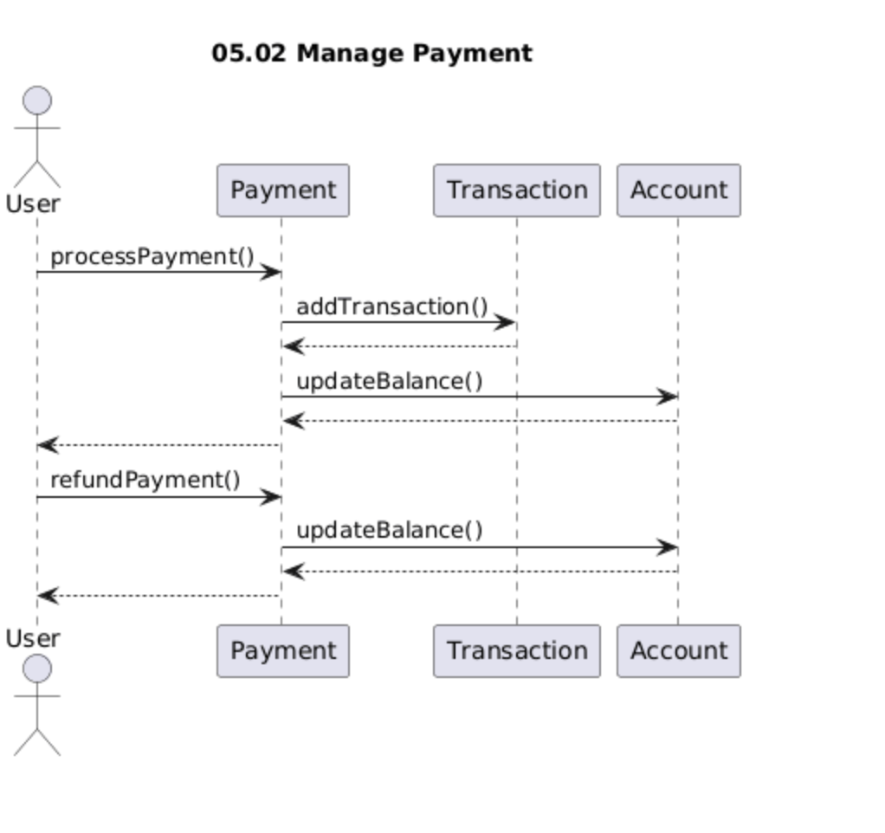
F1nance UML Sequence Diagram
Use Case Scenario
The user pays a bill or subscription fee by calling processPayment() on the Payment object.
As part of this, the system records the financial movement by sending addTransaction() to Transaction and then adjusts the account’s money with updateBalance() on Account.
If something goes wrong or a refund is required, the user triggers refundPayment()on Payment, which again calls updateBalance() on Account to reverse or correct the amount.
The user then sees the final payment and refund status reflected in their account.

Slide 9
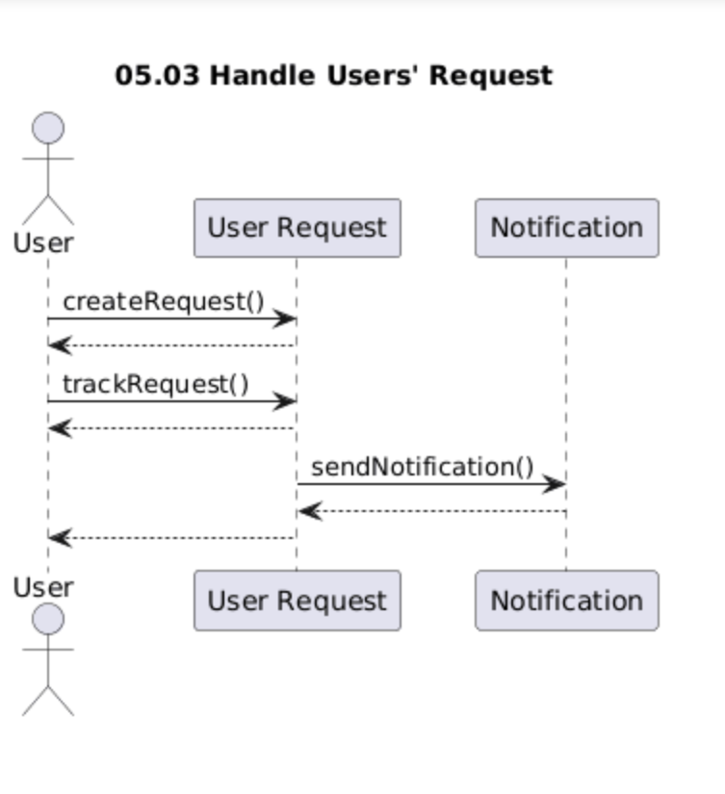
F1nance UML Sequence Diagram
Use Case Scenario
When the user has a problem or question, they open the support area and call createRequest() on User Request, which creates a new ticket with the details of their issue.
Over time, the user can return to the app and use trackRequest() to see how that ticket is progressing or whether staff have added any responses.
When the request is created or updated, the system calls sendNotification() on Notification, so that either the support team or the user is informed about new activity on the request.

